Slide 1

AES Advanced Encryption Standard
Symmetric Encryption
Cryptography & Network Security

Slide 2
Need for New Standard? AES
DES had been used for a long time
Replacement was needed
Theoretical attacks that could break it
Demonstration of exhaustive key search attacks
Could use Triple DES but too slow
US NIST issued call for ciphers in 1997
15 candidates accepted in June 1998
5 were shortlisted in 1999
Rinjadel was selected as the AES in October 2000
In the Rinjadell Proposal, the block length and the key length can be 128, 192, 256
AES standard limits it to 128 bits, but key length can be varied
Easy to implement both in hardware and software
Resistant against all known attacks.

Slide 3
AES
For the AES algorithm, the length of the input block, the output block and the State is 128 bits. This is represented by Nb= 4, which reflects the number of 32-bit words (number of columns) in the State.
For the AES algorithm, the length of the Cipher Key, K, is 128, 192, or 256 bits. The key length is represented by Nk= 4, 6, or 8, which reflects the number of 32-bit words (number of columns) in the Cipher Key.
First Lets Do Mathematics for Finite Field(How it is done in AES)
Addition (Simple XOR), 57 and 83 =D4 (all in Hexadecimal)
Multiplication (57 ·83)=C1 represent in polynomials, Multiply and then modulo x8+x4+x3+x1+1 or simply 11B

Slide 4
AES algorithm
KeyExpansion—round keys are derived from the cipher key using Rijndael's key schedule
Initial Round
AddRoundKey—each byte of the state is combined with the round key using bitwise xor
Rounds
SubBytes—a non-linear substitution step where each byte is replaced with another according to a lookup table.
ShiftRows—a transposition step where each row of the state is shifted cyclically a certain number of steps.
MixColumns—a mixing operation which operates on the columns of the state, combining the four bytes in each column.
AddRoundKey
All of above correspond to one round.
Number of rounds is 9 if both the block and the key are 128 bits long. 11 if either the block or the key is 192 bits long, and neither of them is longer than that. 13 if either the block or the key is 256 bits long
Final Round (Final round doesn’t have mixedColumns)
SubBytes ـ ShiftRows ـAddRoundKey

Slide 5
AES algorithm
Encryption Algorithm (128-bit key version)
Cipher(byte in[16], byte out[16], word w[44]) begin byte state[4,4] //The input state = in AddRoundKey(state, w[0, 3]) for round = 1 step 1 to 10 SubBytes(state) ShiftRows(state) MixColumns(state) AddRoundKey(state, w[round*4, (round+1)*4-1]) end for SubBytes(state) ShiftRows(state) AddRoundKey(state, w[40, 43]) out = state end

Slide 6

AES : Key Expansion
Prior to encryption or decryption the key must be expanded. The expanded key is used in the Add Round Key function
AES (Rijndael) uses a key schedule to expand a short key into a number of separate round keys. This is known as the Rijndael key schedule.
Rijndael's key schedule utilizes a number of operations, which will be described before describing the key schedule.
Rotate
The rotate operation takes a 32-bit word like 1D 2C 3A 4F and rotates it eight bits to the left such that the high eight bits "wrap around" and become the low eight bits of the result.
2C 3A 4F 1D

Slide 7
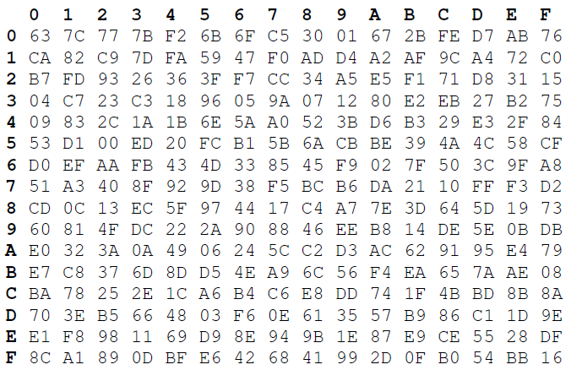
AES : Key Expansion
SubWord: This step applies the S-box value substitution as to each of the 4 bytes in the argument. The table is. For 54, 20 is selected. For E1, F8

Slide 8
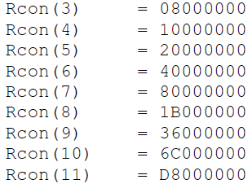
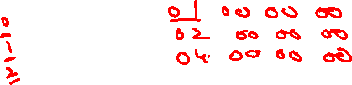
AES : Key Expansion
Rcon[i/NK - 1]
the rcon values can be calculated using 2^{(i-1)} mod 229 followed by 6 ‘0’s
For example for a 16 byte key
Rcon is first called in the 4th round
(4/(16/4))-1=0
In this case Rcon will return
01000000
For a 24 byte key Rcon is first called
in the 6th round (6/(24/4))-1=0
An exclusive Or is done with this Rcon Value

Slide 9
AES : Key Expansion
The key schedule w is generated in the following form:
The first four words (w[0] through w[3]) of the key are the incoming cipher key.
To calculate w[i] for i from 4 to 43:
Set temp = w[i-1]
If i = 4, 8, 12, 16, ..., 40 (multiples of 4)
Rotate this word left one byte
Replace each byte (using the same substitution function as SubBytes)
Do an exclusive-or with the round constant Rcon[i]
Set w[i] = w[i-4] xor temp

Slide 10
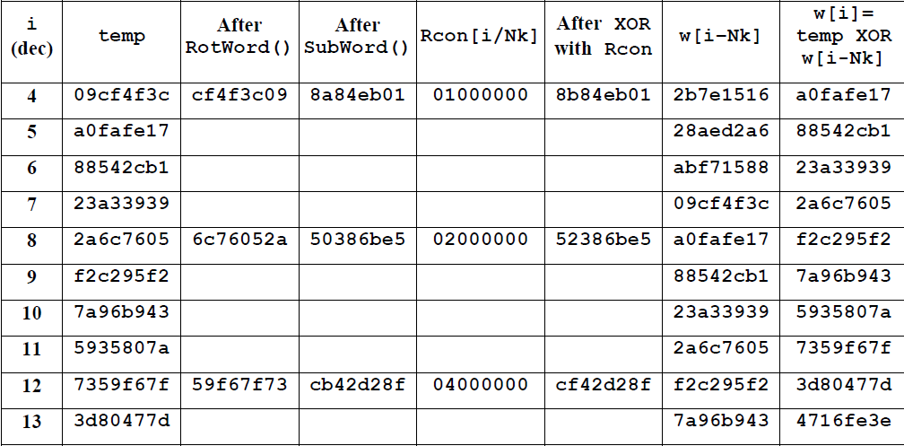
Key expansion example
Cipher Key = 2b 7e 15 16 28 ae d2 a6 ab f7 15 88 09 cf 4f 3c
for Nk = 4, which results in w0 = 2b7e1516 w1 = 28aed2a6 w2 = abf71588 w3 = 09cf4f3c
([i/Nk]-1)

Slide 11
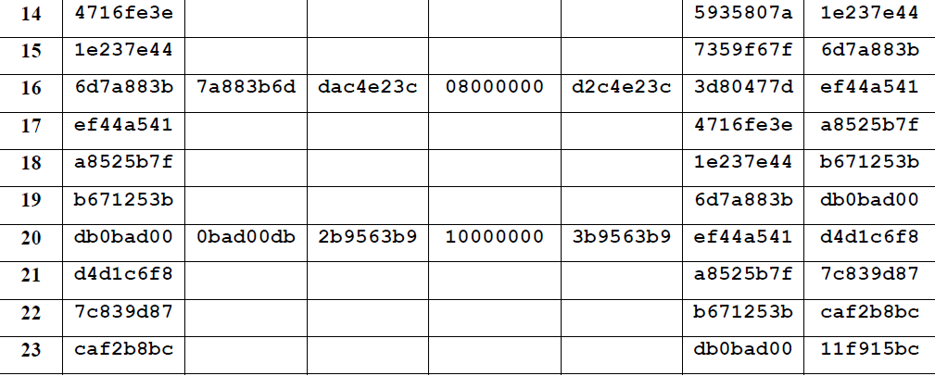
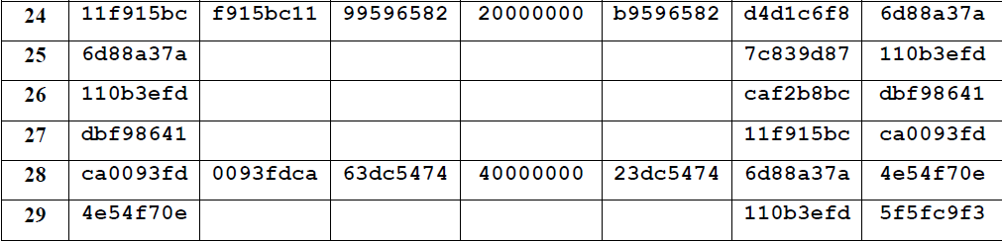
Key expansion example

Slide 12
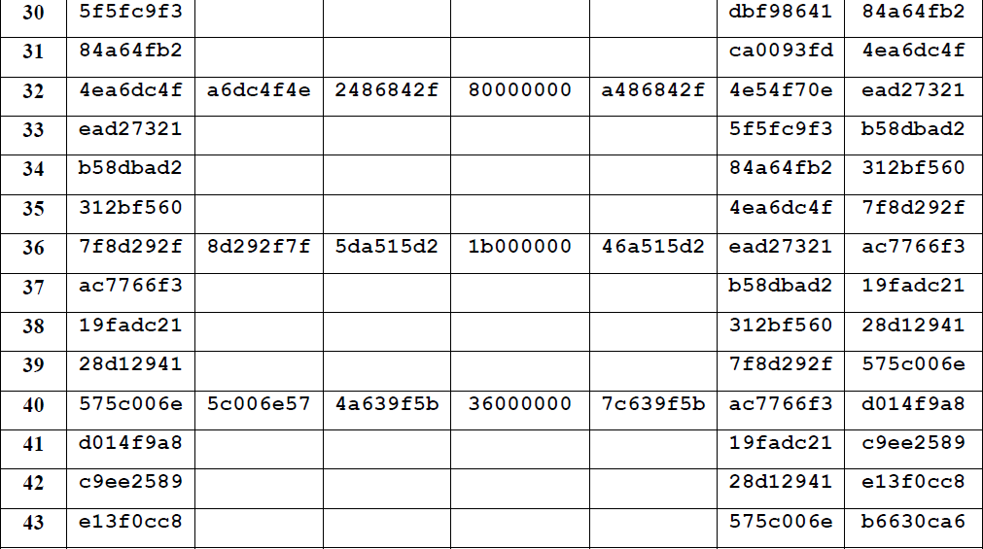
Key expansion example

Slide 13
Key expansion
For this example
Round 0 key: w0,w1,w2,w3= 2b 7e 15 16 28 ae d2 a6 ab f7 15 88 09 cf 4f 3c
Round 1 key: w4,w5,w6,w7= a0 fa fe 17 88 54 2c b1 23 a3 39 39 2a 6c 76 05
------
------
-------
Round 10 key: w40,w41,w42,w43=d0 14 f9 a8 c9 ee 25 89 e1 3f 0c c8 b6 63 0c a6
------------------------------------
Let us look at another example now

Slide 14
Key expansion
Key = 54 68 61 74 73 20 6D 79 20 4B 75 6E 67 20 46 75
Plaintext = 54 77 6F 20 4F 6E 65 20 4E 69 6E 65 20 54 77 6F
w[0] = (54; 68; 61; 74)
w[1] = (73; 20; 6D; 79)
w[2] = (20; 4B; 75; 6E)
w[3] = (67; 20; 46; 75)
And then we can get
W[4]= (E2; 32; FC; F1)
w[5] = (91; 12; 91; 88),
w[6] =(B1; 59;E4;E6),
w[7] = (D6; 79;A2; 93)

Slide 15
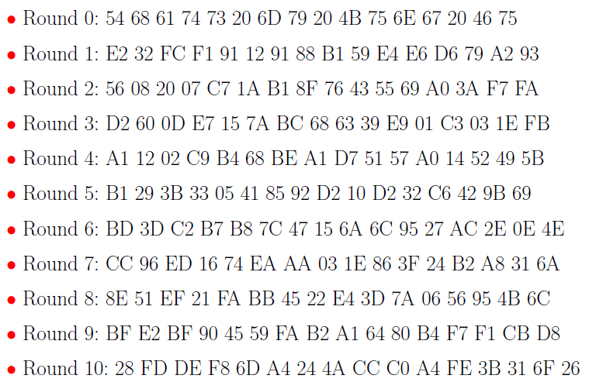
Key expansion
For this example we will get

Slide 16
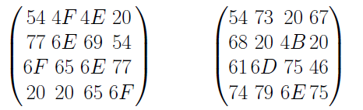
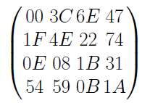
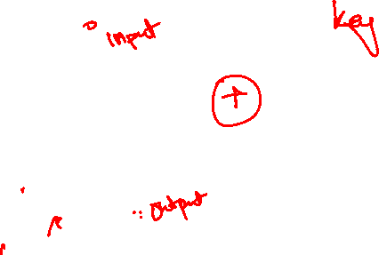
AES : Round 0 Add Round Key
Now as we are done with Key expansion we can move on with Add Round Key (Before regular rounds: see algorithm)
In this round we simply Add (XOR) the state matrix(input) with the round key which in this case is key 0.
Note that the entries are in column order
State matrix(input) Round 0 key
Xoring the corresponding entries we will get
which is our Initial State matrix for regular rounds.

Slide 17
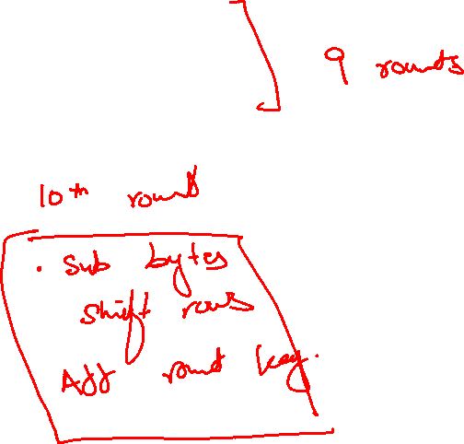
Regular Rounds:
Next come the ten rounds
The steps in Regular rounds are
SubBytes
ShiftRows
MixColumns
AddRoundKey

Slide 18
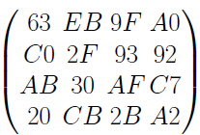
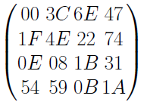
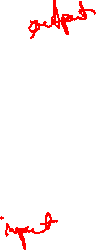
SubBytes
current State Matrix is
substitute each entry (byte) of current state matrix by corresponding entry in AES S-Box (Already given)
for instance: byte 6E is substituted by entry of S-Box in row 6 and column E, i.e., by 9F
this leads to new State Matrix
this non-linear layer is for resistance to dierential and linear cryptanalysis attacks

Slide 19
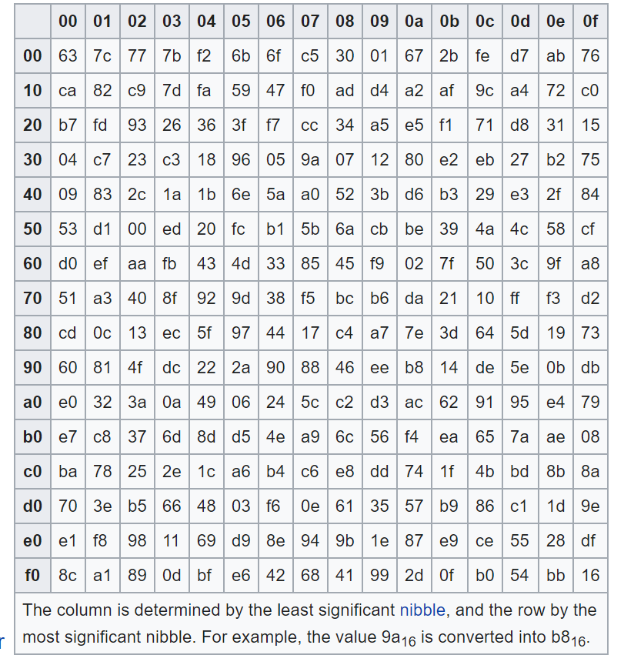
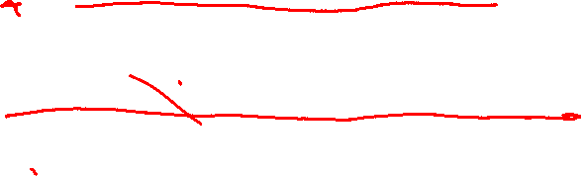

Slide 20
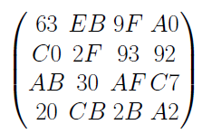
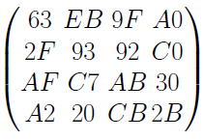
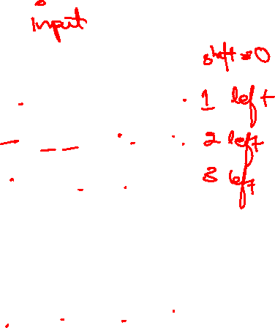
ShiftRows
the current State Matrix is
Four rows are shifted cyclically to the left by offsets of 0,1,2, and 3
The new State Matrix is
This linear mixing step causes diffusion of the bits over multiple rounds

Slide 21
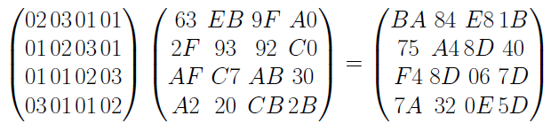
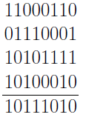
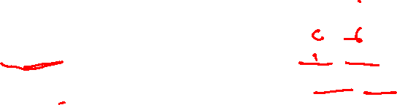
MixColumns
Mix Column multiplies A fixed matrix against current State Matrix:
entry BA is result of (02 * 63) (03 * 2F) (01 *AF) (01 * A2):
02 *63 = 00000010 * 01100011 = 11000110
03 * 2F = (00000011 * 00101111) = 01110001
01 * AF = AF = 10101111 and 01 * A2 = A2 = 10100010
hence Xoring all four
We get
10111010=BA

Slide 22
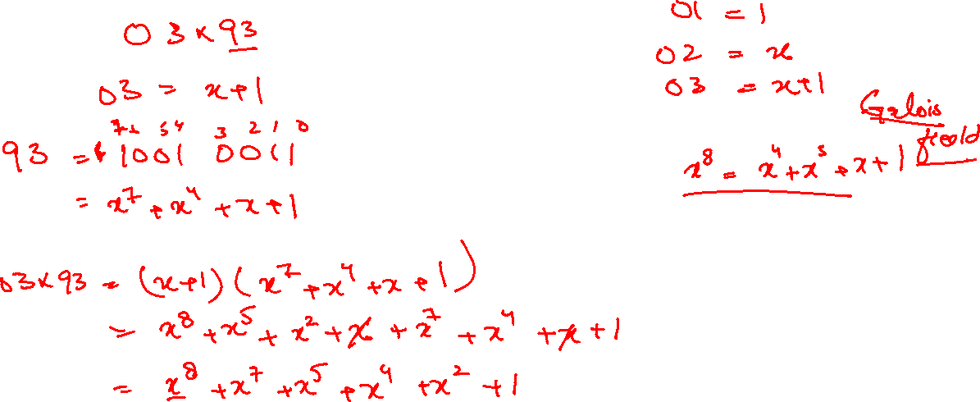

Slide 23
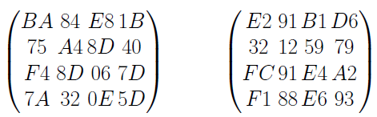
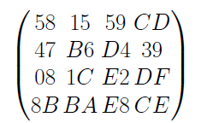
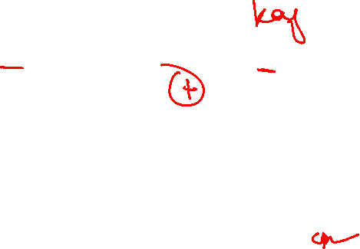
AddRoundKey
State Matrix and Roundkey No.1 Matrix:
XOR yields new State Matrix
AES output after Round 1: 58 47 08 8B 15 B6 1C BA 59 D4 E2 E8 CD 39 DF CE

Slide 24
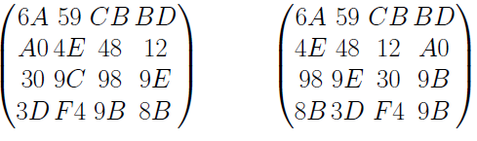
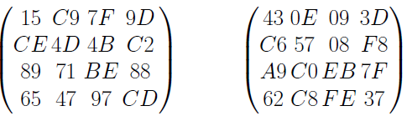
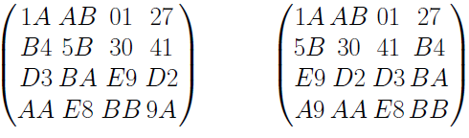
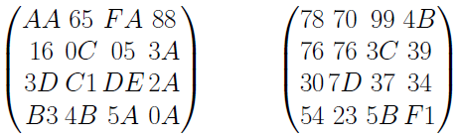
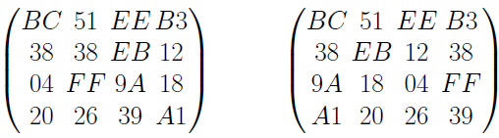
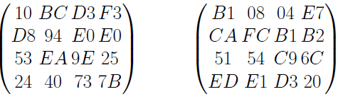
Regular Rounds: 9 for 128 bit
For Round 2 we will get
For Round 3 we will get
For Round 4 we will get

Slide 25
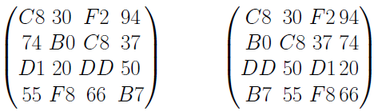
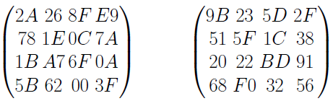
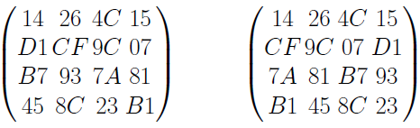
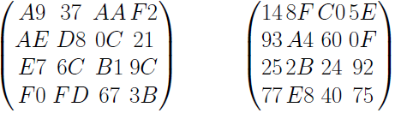
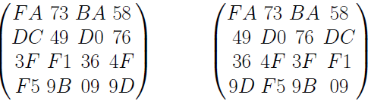
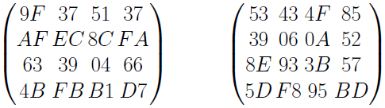
Regular Rounds: 9 for 128 bit
For Round 5 we will get
For Round 6 we will get
For Round 7 we will get

Slide 26
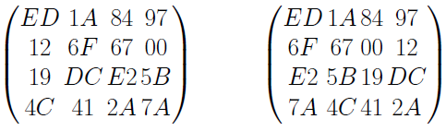
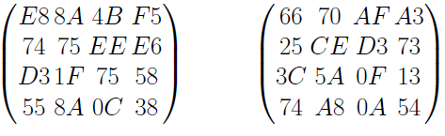
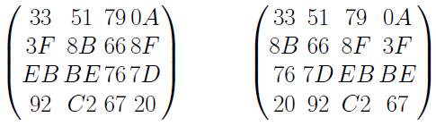
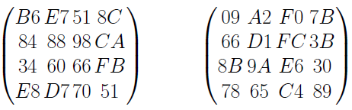
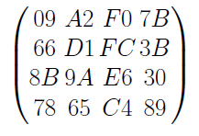
Regular Rounds: 9 for 128 bit
For Round 8 we will get
For Round 9 we will get
So the final state matrix after regular rounds will be

Slide 27
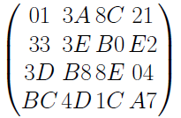
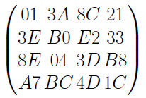
Last Round
The steps in Last rounds are
SubBytes
ShiftRows
AddRoundKey
Input is the state matrix after round 9
After SubBytes we get
ShiftRows results in

Slide 28
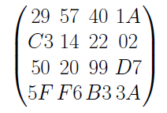
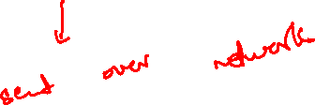
Last Round
After Add Round key we get
Which is our ciphertext: Read as
29 C3 50 5F 57 14 20 F6 40 22 99 B3 1A 02 D7 3A

Slide 29
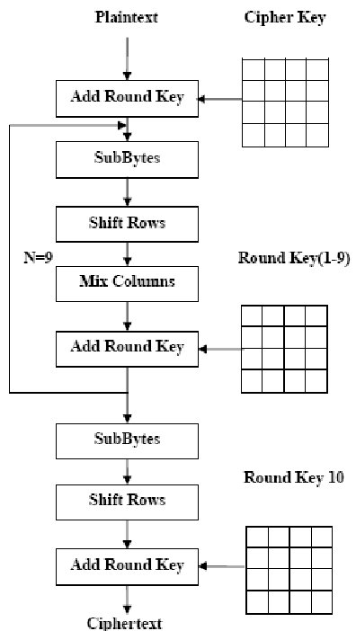
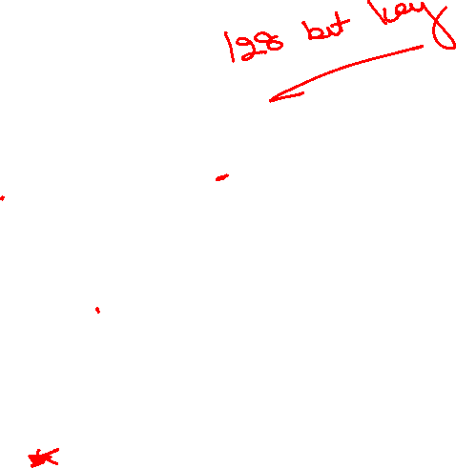

Slide 30



Slide 31


Slide 32

Inverse mix column

Slide 33
References
https://en.wikipedia.org/wiki/Advanced_Encryption_Standard
https://en.wikipedia.org/wiki/Block_cipher_mode_of_operation
https://en.wikipedia.org/wiki/Rijndael_S-box
https://en.wikipedia.org/wiki/Rijndael_MixColumns

